Slide 1



Radon Testing Survey for
MCAS Beaufort
Unit Safety Reps / Building Tenants / Managers / Occupants

Slide 2
Training Objectives
Provide a basic understanding of radon and why it is a concern.
Provide an overview of the MCAS Beaufort's radon testing program.
Discuss how the radon testing results will be communicated.

Slide 3
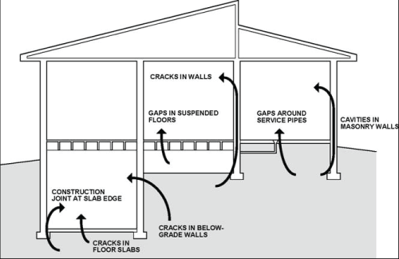
What is Radon?
Radon is a naturally occurring, odorless, colorless radioactive gas that is released from rock, soil, and water as part of the natural decay of uranium (EPA 2013).
Due to radon being a single atom gas, unlike oxygen or nitrogen (O2 or N2), it can easily infiltrate buildings through cracks and voids in concrete, mortar, and sheetrock.
Although elevated indoor radon can come from water supplies or building materials, almost always, the problem comes from radon emanation from the soil under or surrounding a building (EPA 2012).
Radon is a cancer-causing radioactive gas that you cannot see, smell, or taste that comes from the soil beneath buildings and may accumulate indoors.
Source: http://foundationhandbook.ornl.gov/handbook/section1-4.shtml

Slide 4
Why does radon enter a building?
It’s all about the pressure differentials.

Slide 5
Why is Radon a Concern?
Radon decays into radioactive particles known as radon decay products.
These particles are easily inhaled and deposited in the lungs where they can damage sensitive lung tissue.

Slide 6
Why is Radon a Concern?
Although radon levels in outdoor air (≈0.2 picocuries/Liter (pCi/L)) pose a relatively low threat to human health, indoors, radon can accumulate to dangerous levels.
Exposure to indoor radon is the second leading cause of lung cancer in the United States and the number one cause among nonsmokers (US Surgeon General 1989).
The US EPA has developed action levels of 4-20 pCi/L requiring mitigation within 2 years; and 20-200 pCi/L requiring mitigation within 6 months.
Basements and rooms on the ground floor typically have the highest levels of trapped indoor radon.
HVAC systems impact the air distribution within a room and therefore, can significantly impact indoor radon levels without notice.

Slide 7
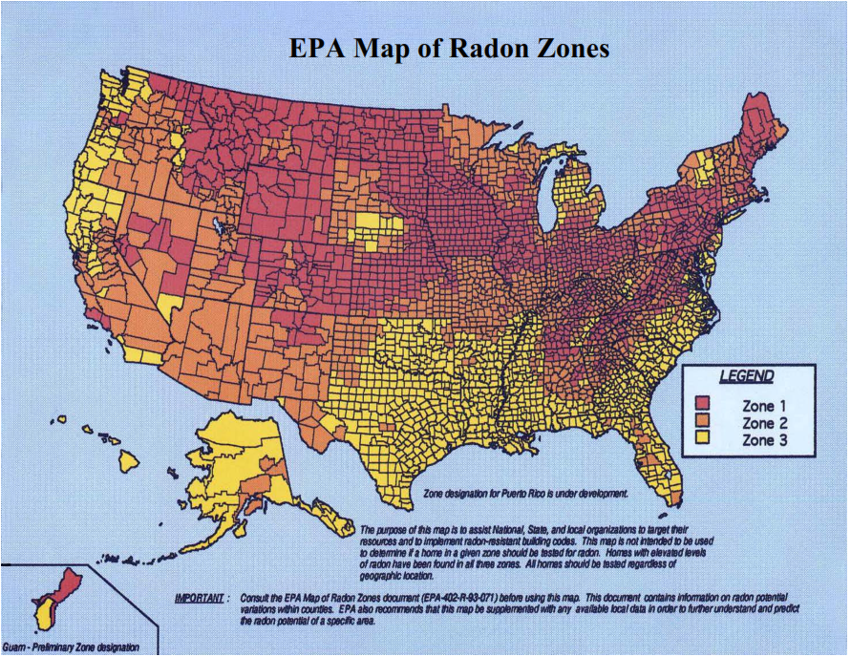
EPA Map of Radon Zones (by County)
Zone 1 > 4.0 pCi/L
Zone 2 > 2 > 4.0 pCi/L
Zone 3 < 2.0 pCi/L
MCAS Beaufort is in a Zone 3 area – low risk area
Notes:
Important to note that the Zone designations represent average radon levels at the county level. It does not mean all areas inside Zone 1 will have measured radon levels >4 pCi/L. Similarly, it does not mean all areas inside Zones 2 and 3 will have measured radon levels <4 pCi/L.
Zone 1 = Avg indoor radon screening levels greater than 4 pCi/L
Zone 2 = Avg indoor radon screening levels from 2 - 4 pCi/L
Zone 3 = Avg indoor radon screening levels < 2 pCi/L

Slide 8
Why are we Testing for Radon?
Navy Radon Policy (established in Chapter 25, Section 3.2 of OPNAV M-5090.1 (US Navy 2014) )
  Instructs all Navy installations to implement Navy Radon Assessment and Mitigation Program (NAVRAMP) worldwide.
US Marine Corps Radon Policy (established in Volume 6, Chapter 3, Paragraph 0307 of MCO 5090.2 (11 June 2018))
  States that all Marine Corps installations must implement all phases of the NAVRAMP.
As a precautionary action to ensure the health of its military personnel, civilians, and their families. This remains the primary concern of the Navy, Marine Corps, and the Commanding Officer.

Slide 9
Navy Radon Assessment and Mitigation Program (NAVRAMP) Overview
The NAVRAMP overall objective: To test all Navy & Marine Corps Installations worldwide using a sampling protocol that would ensure an overall 95% statistical confidence that no single building would have elevated radon potential.
Includes procedures for:
  Implementation of radon resistant new construction
  Radon testing
  Radon mitigation (≥ 4 pCi/L)
  Radon system maintenance (Buildings that have radon mitigation systems)
Guidance document – Revised in January 2017

Slide 10
NAVRAMP Radon Testing
Screening – Selected Buildings Tested
Assessment – All Buildings/Rooms Tested
Monitoring – Every 5 years (or 2 years if buildings have a radon mitigation system)
*The purpose of the radon assessment is to test all ground contact, occupied (>4 hours/day) or easily occupiable rooms (vacant room or office space that can be easily converted into occupiable or living space)

Slide 11
Radon Testing at MCAS Beaufort
Over 90 buildings will be tested as follows:
  17 Tier 1 Buildings (Barracks, schools, child centers, brigs).
  9 Tier 2 Buildings (Command and communication facilities, fire stations, lodges, and security buildings).
  64 Tier 3 Buildings (Offices and administrative buildings, exchanges, commissary, shops, recreational facilities, warehouses, and other work areas).
  3 Tier 4 Buildings (atypical buildings such as armories and buildings with unique construction).
Typical areas to be tested include:
  Offices / cubicle areas / conference rooms / barracks
  Not testing storage areas, communication closets, mechanical rooms, etc.

Slide 12
Radon Testing (continued)
Radon detectors are planned to be placed in testable buildings in March to April 2021.
Detectors will be placed in testable basements or 1st floor locations that are “occupied” or “easily occupiable”.
All locations will have two devices (100% duplicates).
These detectors will be kept in place for 1 year and will be retrieved approximately one year after they are placed in the buildings.
An attrition check will be conducted approximately 6 months after deployment (≈November 2021).

Slide 13
Radon Detection
Indoor radon measurements are relatively simple to perform and are essential to assess radon concentration in a building.
Radon concentrations may vary from day to day, due to weather, and can vary greatly from season to season which makes it important to gather data throughout the year.
Because the risk to radon exposure is based on an annualized dose, both the EPA (EPA 2012) and the World Health Organization (WHO) recommend that the radon testing be performed for as long as practical to ensure a representative measurement.

Slide 14
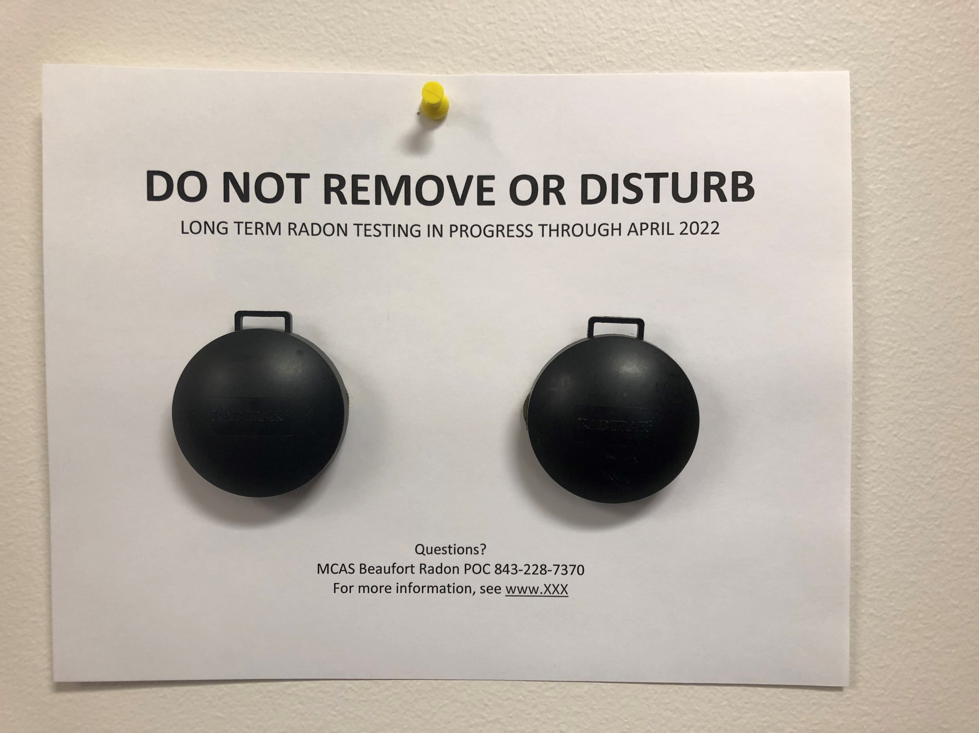
What does the Radon Detector Look Like?
RadTrak2 Detector – Appearance:
  composed of a passive detector located inside an anti-static black plastic housing
  just under 2.5 inches in diameter, with a flat base.
RadTrak2 Detector – Design:
  designed to be placed horizontally or hung vertically.
  designed for long-term measurements (allows for a wide range of radon levels to be measured)
Notes:
There are other types of Radon Detectors. The RadTrak2 is an alpha track type detector.

Slide 15
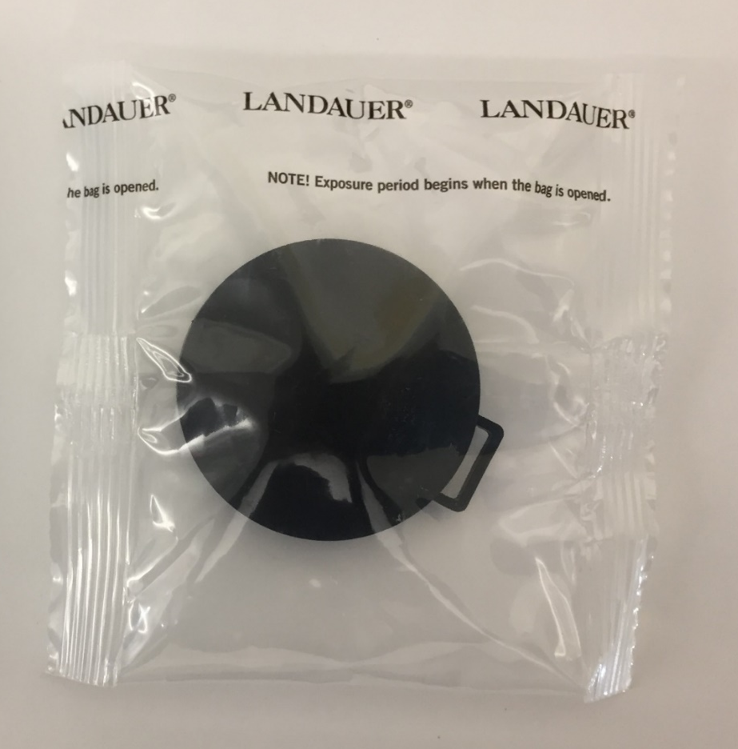
How does the Radon Detector Work?
This passive, Alpha track detector does not emit noise or harmful chemicals, and requires no special attention.
Once the radon-proof bag is open, radon gas is able to enter the detector through a very small gap between the top and the bottom.
The detector contains a strip of transparent plastic film. When radon gas in the air decays, alpha particles are created. When these hit the transparent plastic film, tracks are formed.
After the measurement period, an analysis is performed using an image scanner. The number of tracks is used to calculate the radon level and expressed in pCi/L.

Slide 16
NAVRAMP Device Placement Criteria
The detectors will be placed in a location where the probability of being disturbed is reduced. The detectors should be:
  Away from air currents (this would impinge upon the device)
  Exposed to room air (no obstructions surrounding device)
  Between 2 and 8 feet from the floor
  No closer than 12 inches from the ceiling
  Not directly attached to lights, sprinkler lines, etc.
  At least 3 feet from openings (windows & exterior doors)
*Contractors will be the ones placing the detectors, conducting attrition checks, and retrieving the detectors.

Slide 17
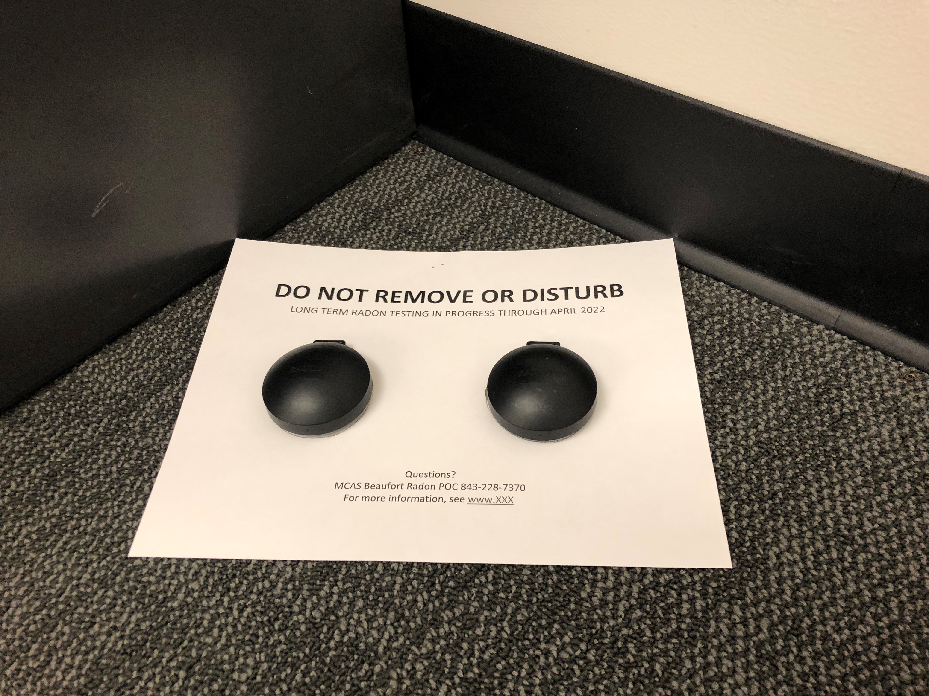
What Should I do if a Detector Falls on the Floor?
After the detection devices are placed, we ask that they not be disturbed for the one year they will be in place.
Do not cover any device or move any equipment that moves air, such as a fan, near the device.
Should one fall to the floor, be disturbed or need to be relocated, please contact the phone number on the face of the card to which the device is attached.
On this same card you will also find a website to which you can go to for more information on radon that may be helpful.

Slide 18
How will the Radon Testing and Results be Communicated?
MCAS Beaufort is using a variety of means to notify all concerned regarding the radon testing including email, web postings, and other means.
As soon as the radon testing results are available and evaluated (August to September 2022), MCAS Beaufort will make a determination of the next steps.
    Any exceedances would be assessed on a case by case basis.
    MCAS Beaufort is coordinating with Marine Corps public health officials in preparation for assistance, if needed.
    From other NAVRAMP installation surveys, the most common issue and fix involves the HVAC system.

Slide 19
Where can I find more Information about Radon?
Basic information, Q&A, and a Radon Fact sheet, will be located on a website (TBD) and distributed via All Hands email.
https://scdhec.gov/environment/your-home/radon
Also see https://www.epa.gov/radon

Slide 20
Summary
What are we doing?
  Following U.S. Environmental Protection Agency (EPA), Navy and Department of Energy guidelines, the Environmental Department is installing indoor radon monitoring devices to identify if there is a radon risk within our facilities.
Simple definition of Radon:
  Radon is a colorless, odorless, tasteless gas that is produced by the radioactive decay of naturally- occurring uranium and thorium in the soil and rock.
How does Radon get in a facility?
  Radon typically moves up through the ground to the air above. Radon enters a facility from the soil below via simple diffusion through building materials, cracks, and structural openings.
Radon Risks:
  Prolonged exposure to high levels of radon can lead to an increased risk of lung cancer.
What happens if exceedances are found?
  Locations with radon found to be above EPA action levels will be mitigated to reduce radon levels. After mitigation is complete, the locations will be re-tested to verify that mitigation measures were effective in reducing radon to below EPA action levels.
Safety Rep Role:
  Understand the basic testing process, know where to direct questions regarding the Radon Assessment and detectors (POCs, Website, etc.), identify issues with detectors, and assist with attrition/loss rates. Safety Representatives can help ensure MCAS Beaufort gathers reliable data that will be protective of personnel safety and health.

Slide 21
Questions?

Slide 22
Points of Contact
Kelsey Timmerman; (843) 228-7372, kelsey.timmerman@usmc.mil (NREAO)
Chris Vaigneur; (843) 228-7370, christoper.vaigneur@usmc.mil (NREAO)
First Lieutenant Kevin L. Buss, (843) 228-6123, Kevin.buss@usmc.mil. (CommStrat/Public Affairs)

